Slide 1
Relevance Model
Manager: Talluri Nagasai Venkata Sudheer
Krishnamoorthi Bagya Employee Id:6468225(M404202)
Mentors: RFIT R & A India
Nitin Sen Credit Suisse Bangalore
Vishal Chauhan

Slide 2
Problem Statement
Build a model that quantifies the relation between a entity and a document so that we will be able to find out which documents are more related to that entity by considering direct and indirect relevance of the document with that entity.
Experiment on all the NLP tools present and find which perform NER at the best.

Slide 3
Techniques used for Model
Information Based Ranking using PageRank Algorithm
Information Based Ranking using Gensim TextRank
Positional Ranking
Positional Ranking embedded with Co-reference resolution
Tools used for Model
Spacy 2.1.3 Version for Natural Language Processing
NeuralCoref 4.0 Version for Anaphora Resolution
Networkx module for Page Rank Implementation
Gensim Module for TextRank Implementation
SPARQLWrapper module for querying graph database
AllenNLP for better NER and better Anaphora Resolution

Slide 4
Concept of Relevance
Relevance is simply knowing which entity that the article belongs to so that we can predict that events happening as per the article are related to that entity.
There are two types of Relevance,
Direct Relevance is a type of relevance where the entity itself is directly mentioned in the article.
Indirect Relevance is when the related entities or properties of entities are present in the article.
Performing Direct Relevance is easier but to perform Indirect relevance we need to have some knowledge of entities and their related entities and techinically we call that a “Knowledge Base”.
Instead of creating a knowledge base by our own which requires huge data and consumes a lot of time, we can use the existing knowledge bases like WikiPedia, NYT corpus or Wiki News. Here we use “DBPedia” which is a graph database of WikiPedia data.
To Query any database we require a query language, here SPARQL(pronounced as SPARKLE) does that job for us. We have a SPARQLWrapper in python to execute the queries.

Slide 5
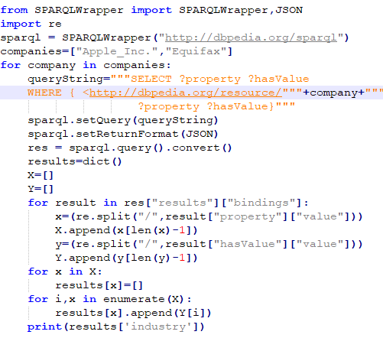
Code For Creation of Knowledge Base
This entire database is a set of “subject-predicate-object” triples i.e. RDF data can also be considered as a table with subject, predicate, object columns.
We can use SELECT query of SPARQL in-order to retrieve data from DBPedia.
Result will be a dictionary of the form shown in Example, Ex: {“alias”:[“Apple Inc.”], “keyPerson”:[“Steve Jobs”, “Tim Cook”], “Products”:[“iMac”, “iPhone”]}
Alias will be considered as equal to mentioning the entity itself and every property will be given priority based on their closure or relation of it with the entity.
We extract the information of S&P 500 companies.

Slide 6
Ranking of Sentences
Before using any math or stat intuition in this, we use common sense to rank the sentences.
Headlines contain the most important and relevant matter in the news article, followed by beginning lines and it decreases from top to bottom.
So, we go for Positional Ranking, where this common sense criteria is applied. If the entity is present in the headline then it is related with high confidence and given a score of 1.0. Scoring for remaining sentences will be seen in next slides.
We can also rank the sentences based on the information present in the document using word embeddings and PageRank/ TextRank algorithm.
We implemented page rank algorithm using word embeddings and networkx module. We also used genism module which contains textrank summarizer( by passing the ratio of summarization =1)

Slide 7
Scoring Metric
Percentile method is used to score the entities present in the document.
We take the intersection of the companies present in the corpus and companies we extracted using NER.
Now we will Rank the sentences based on Information and Position separately.
Then we will have the percentile scoring on ranked sentences.
Percentile score of a single presence=
Score=number of lines below the line where entity is present/Total number of lines
We will average the scores for all the entities and their properties present at different lines, for both information based and positional based ranking and get the final score.

Slide 8
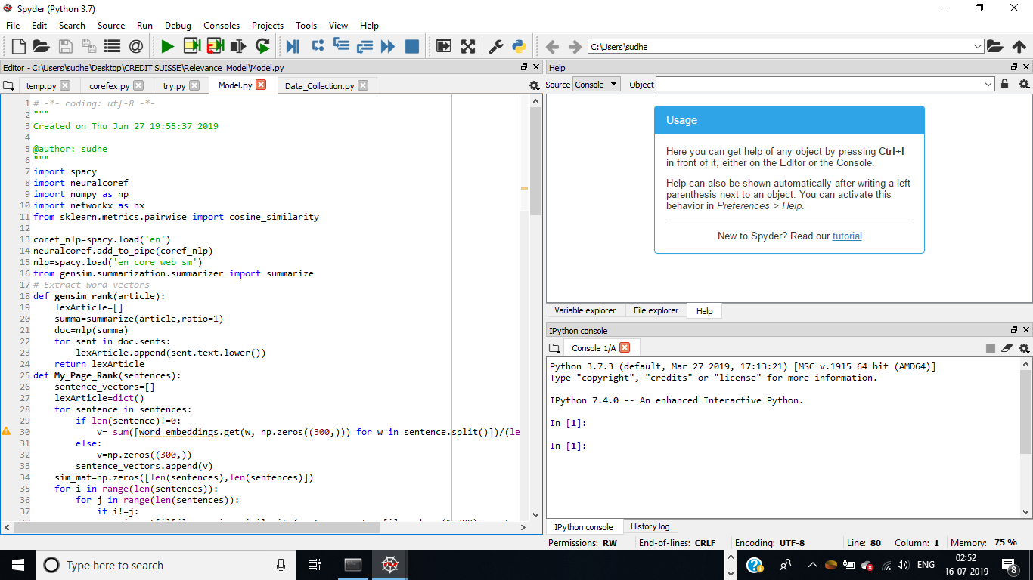
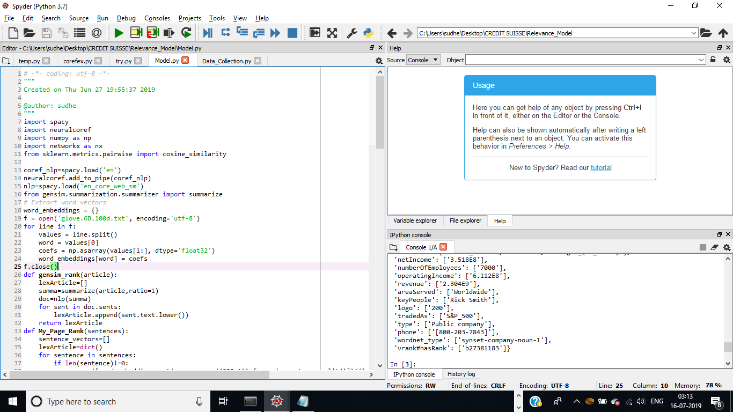
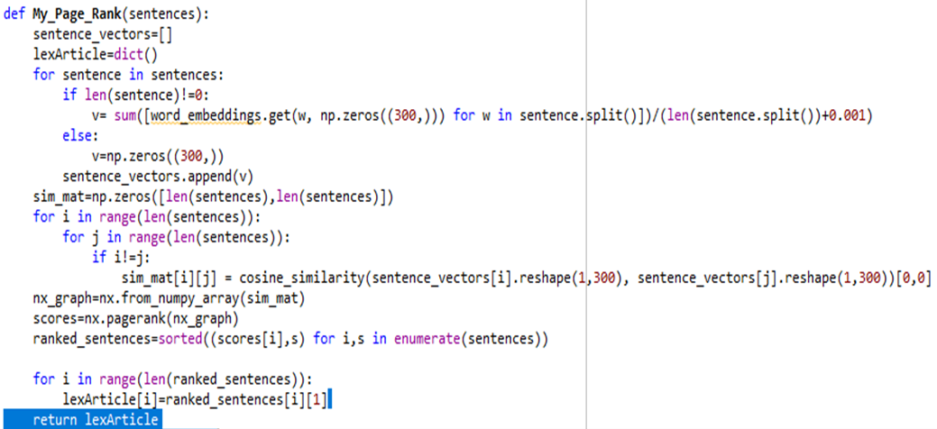
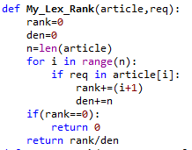
Relevance Model Python Code
Modules to be imported
Glove Embedding
Gensim TextRank
PageRank using python
Information based scoring

Slide 9
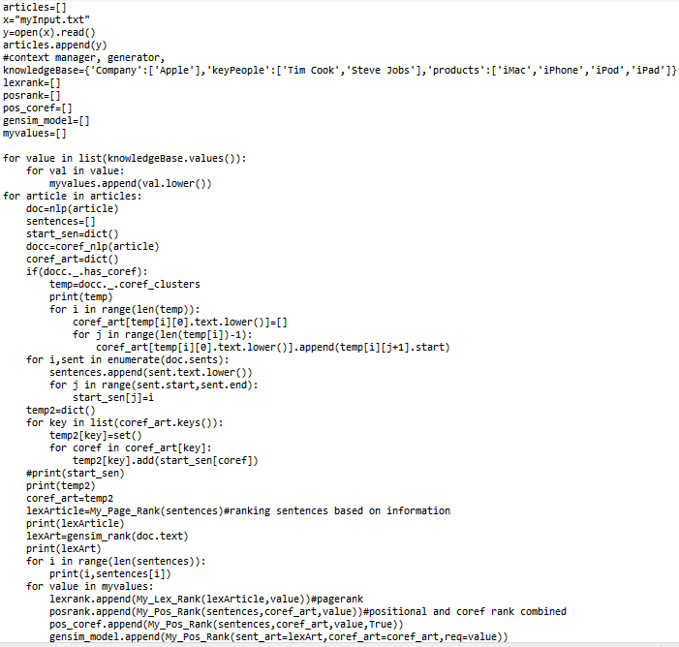
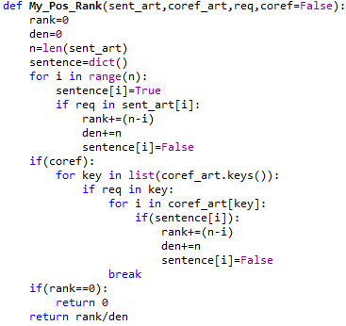

Code to call all the functions and to perform co-reference resolution
Positional Based Scoring
Sample Results

Slide 10
Basic Architecture
Article
Ranking of Sentences
Page Rank
Gensim Text Rank
Positional Ranking
Positional Ranking embedded with Co-reference Resolution
Perform NER to extract Entities using spacy or AllenNLP
DBPedia
Scoring of entities using Percentile Average method by considering direct and indirect relevance
Output:
Entities and Relevance Scores
Knowledge
Base

Slide 11
Experimenting NER’s
After using nltk, spacy modules to find NER, we found that the quality of entities extracted is not satisfactory.
So, we tried StanfordNLP, polyglot, GlounNLP, AllenNLP to perform NER.
After looking at all the results “AllenNLP” Pre-trained model performed the best.
AllenNLP is pyTorch based tool which has pre-trained models for most of the NLP tasks.
We then used AllenNLP Coreference Resolution in Relevance model and found that it performs better than neuralcoref.
Paste the pic of
Allennlp coref

Slide 12
References
SWAT Research Paper (https://arxiv.org/abs/1804.03580) – for understanding refer to rest API mentioned in paper
“Knowledge-Driven Event Embedding for Stock Market prediction” paper(https://pdfs.semanticscholar.org/d03b/9d5081ca64ce4db2f2dfb1e8f478c3bd44c1.pdf)
Entity Salience paper (https://static.googleusercontent.com/media/research.google.com/en//pubs/archive/42235.pdf)
Implementation of PageRank (https://www.analyticsvidhya.com/blog/2018/11/introduction-text-summarization-textrank-python/)
Python Documentation – (https://docs.python.org/3/)
PyPI – (https://pypi.org/)
Spacy (https://spacy.io/) – Refer to spacy v101 course here to learn fast
Anaphora Resolution (https://github.com/huggingface/neuralcoref)
Gensim TextRank (https://radimrehurek.com/gensim/summarization/summariser.html)
SPARQL Rest API – (https://dbpedia.org/sparql)
AllenNLP (https://allennlp.org/) – Go to modules section to implement and use demo section to understand

Slide 13
Some other most used websites
Google – (https://www.google.com/)
GitHub – (https://github.com/)
Stackoverflow – (https://stackoverflow.com/)
Towards Data Science - (https://towardsdatascience.com/)
Medium – (https://medium.com/)
Analytics Vidhya – (https://www.analyticsvidhya.com/blog/)
Lexalytics – (https://www.lexalytics.com/)
Machine Learning Mastery – (https://machinelearningmastery.com/)
Nlphackers.io – (https://nlpforhackers.io/)

